Slide 1
Underwood and Lethbridge revisited
Andrew Edgar
andrewredgar@gmail.com

Slide 2
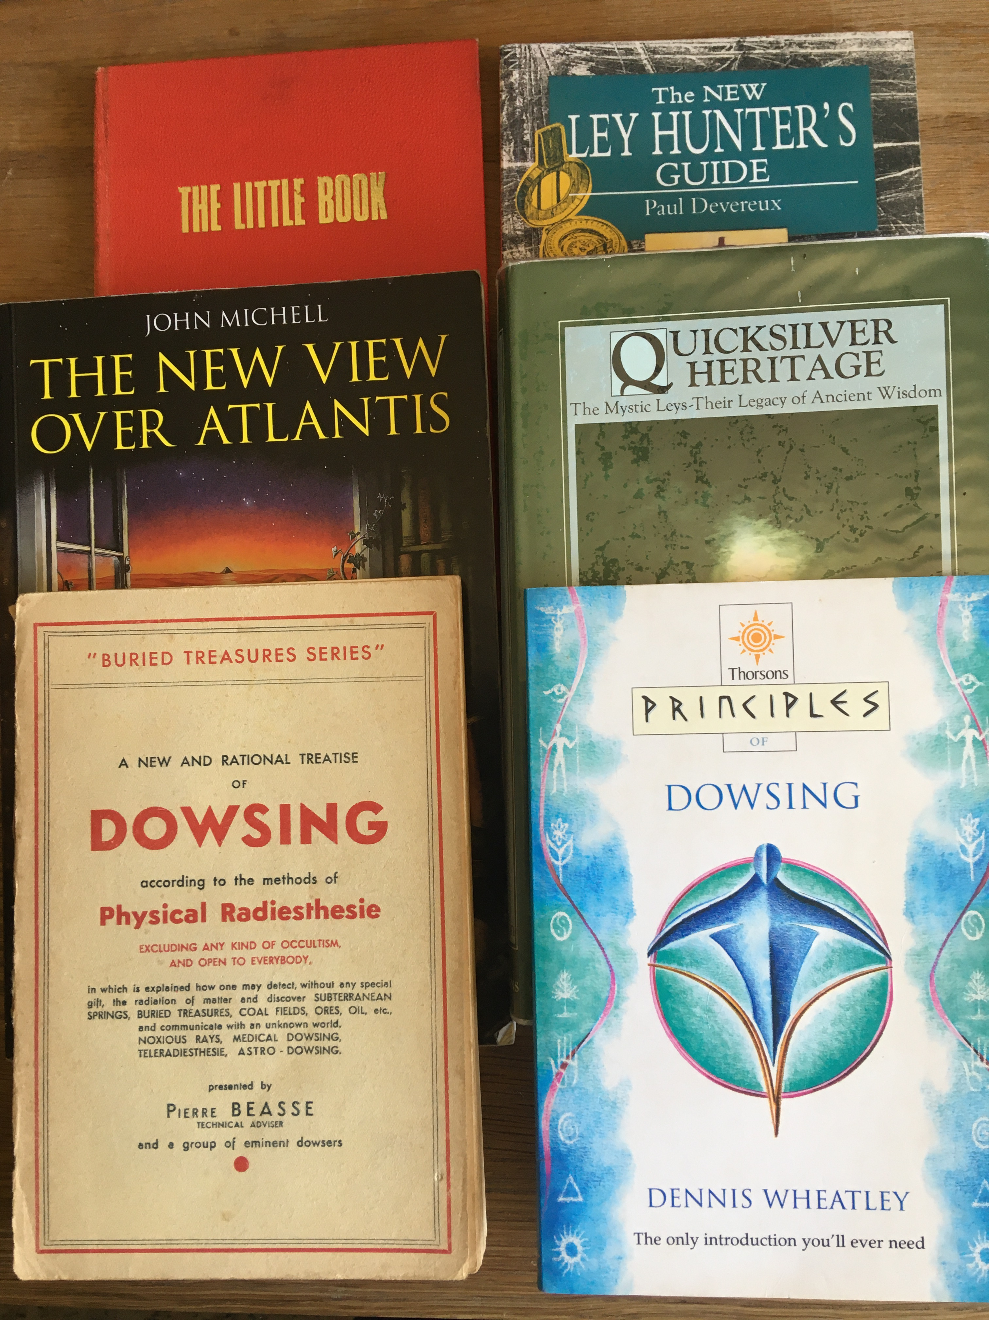
Continuing Relevance?
Can anything new be learnt from the work of dowsers from the 1960s and ’70s?

Slide 3
A first comparison
Guy Underwood (1883-1964)
Engineer (?)
‘Earth energies’ dowser (author of The Pattern of the Past (1969), and numerous articles in the Journal of the BSD).
T. C. Lethbridge (1900-1970)
Explorer, archaeologist, psychic researcher (publishing on boat building, the Picts, hill figures, witchcraft, ghosts, dowsing, the afterlife...).
Notes:
NB Lethbridge on time – Underwood cannot access history, Lethbridge has a complex account of overlapping and repeating time.

Slide 4
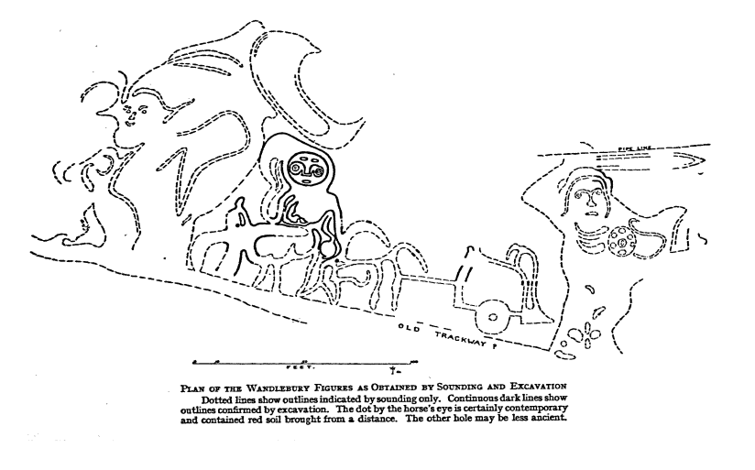
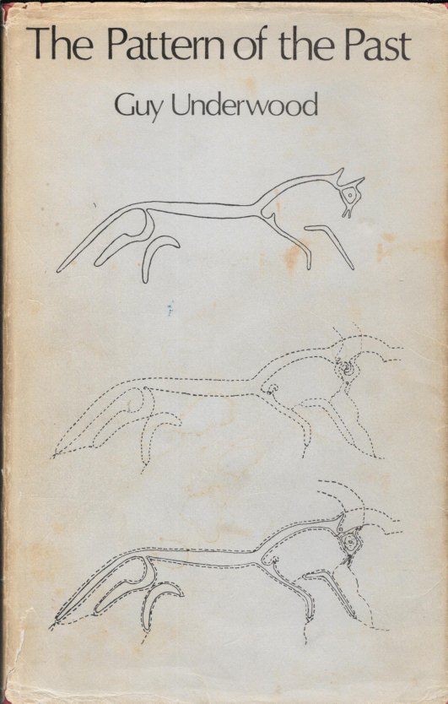
A first comparison
Lethbridge’s recovery of the Wandlebury Figures
Underwood’s dowsing of the Uffington White horse
Notes:
Lethbridge discovered a chalk hill figure, near Cambridge (by testing the earth with metal rods). He later tested, with his pendulum, the pebbles found on site as sling shot.

Slide 5
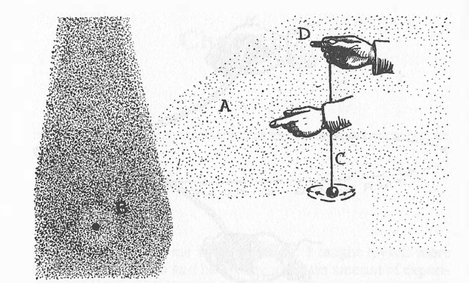
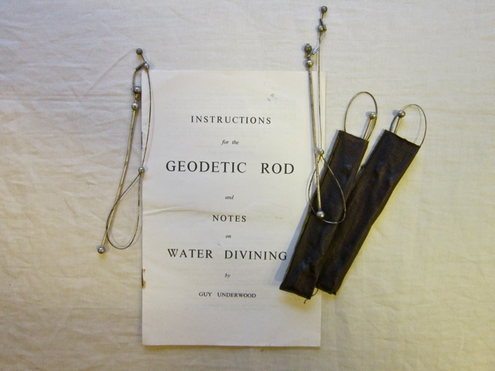
Approaching dowsing
Guy Underwood
A rod dowser – with a distinctive ‘sensitive’ rod.
Tom Lethbridge
A pendulum dowser, focusing on the length of chord (rate) at which the pendulum reacts.
Notes:
‘In fact it seems to me that the pendulum only supplies a means of communication in code between one part of one's mind on Earth and another part not bound up with the human body. It helps anyone who can use it to be in a sense a medium. But there is a great advantage in using the pendulum, for its code can be measured and written down.’

Slide 6
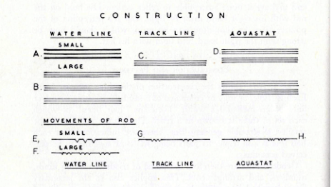
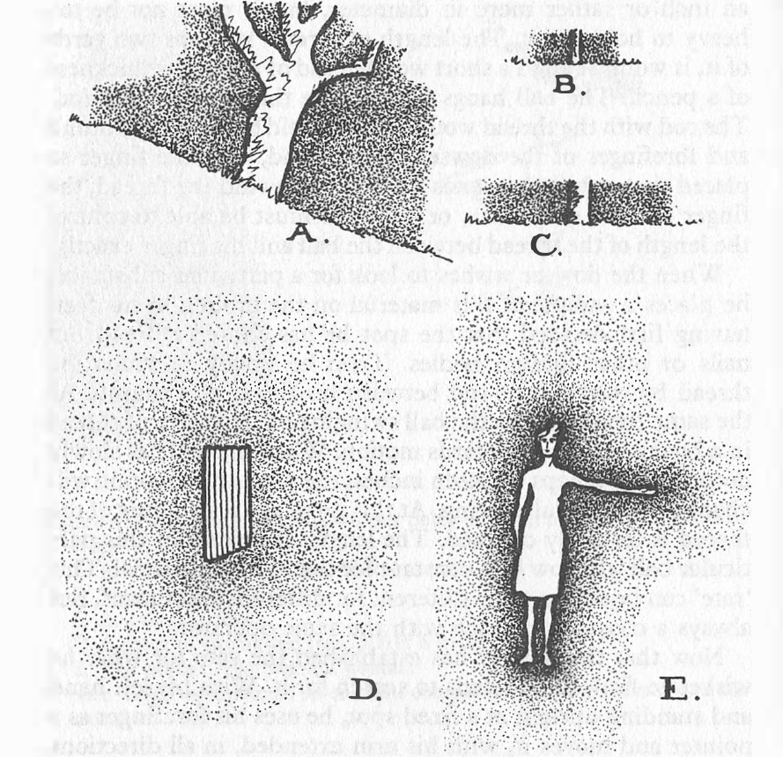
Approaching dowsing
Guy Underwood
Rods react to an ‘earth force.
Geodetic lines are classified in terms of distinctive reactions of the rods.
Tom Lethbridge
The pendulum is a reaction between the electro-magnetic aura of the object and that of the dowser.
Notes:
Add here TCL on nymphs, dryads etc.

Slide 7
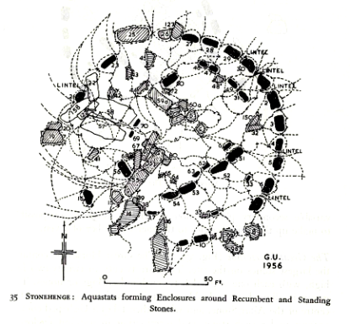
Dowsing and Archaeology
Guy Underwood
Key thesis that ‘ancient’ (pre-Roman) peoples situated and arranged sacred sites according to geodetic lines.
Ancient (rock) art and symbols reflect geodetic lines

Slide 8
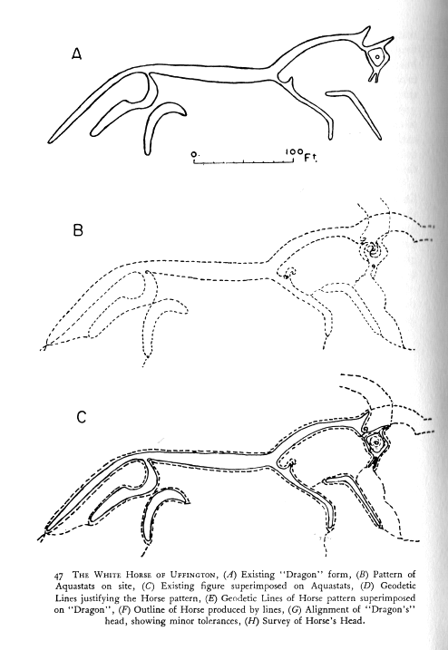
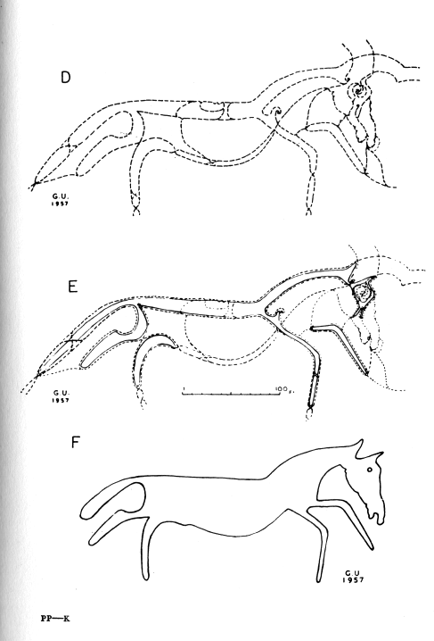
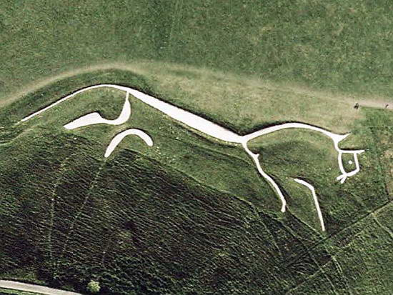
Dowsing and Archaeology
Guy Underwood
Mapping of the geodetic lines shaping the Uffington horse/dragon.

Slide 9
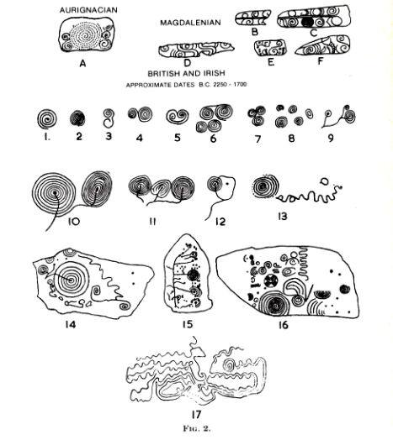
Dowsing and Archaeology
Guy Underwood
The editor of the Journal of the BSD (Col. Bell) notes that: ‘To associate the alignment of roads, buildings and boundaries, and the siting of ancient monuments, with the previous existence of [geodetic] lines of reaction seems to be far fetched’.
Rock art also reflects geodetic lines

Slide 10
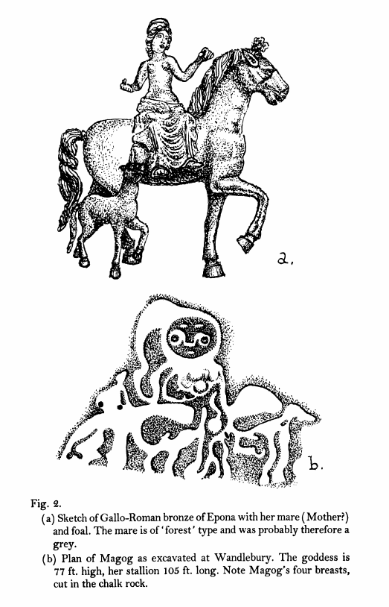
Dowsing and Archaeology
Tom Lethbridge
A professional (if unpaid) archaeologist until 1957. His approach, like Underwood’s, is that of a cultural archaeologist. Much of his work focuses around the possibility of the worship of the goddess Diana, the Great Mother.
Illustration from Witches (1962)
Notes:
Lethbridge’s scientific approach

Slide 11
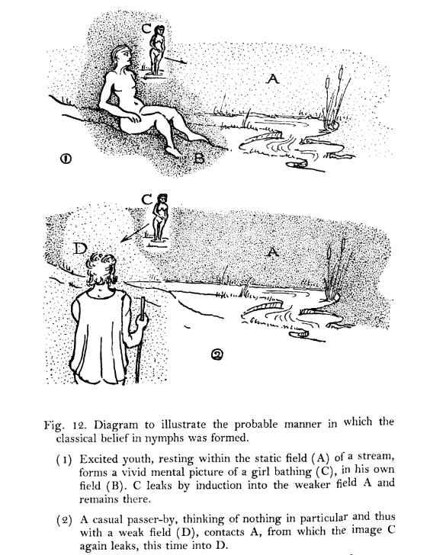
Dowsing and Ghosts
Tom Lethbridge
Ghosts and ghouls are the projection of one person's (emotional) experience of another person onto the 'naiad-field'.
'Are ghosts “television” pictures carried by the force of resonance from a projecting machine in one mind to a receiving machine in another.'
Illustration from Ghost and Diving Rod (1963)
Notes:
Explain naiad field and relationship to dowsing; theory of time

Slide 12
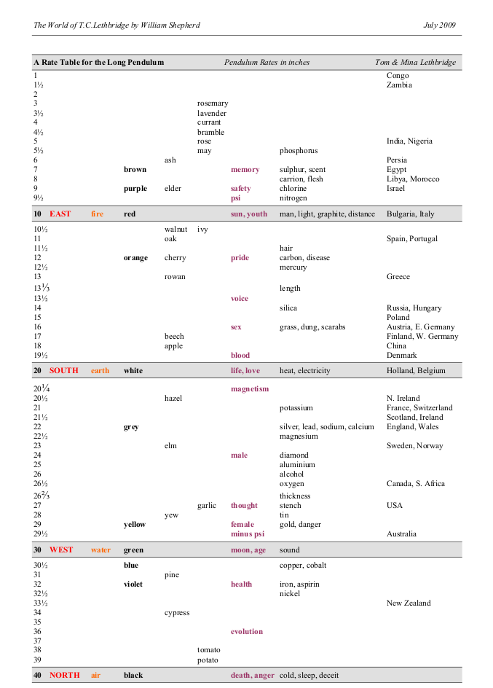
Dowsing and Metaphysics
Tom Lethbridge
By adjusting the length of the pendulum’s chord Lethbridge discovers a series of correspondences between ‘rates’ and substances – but by focusing on key rates (10, 20, 30, 40 inches) this becomes a metaphysics.

Slide 13
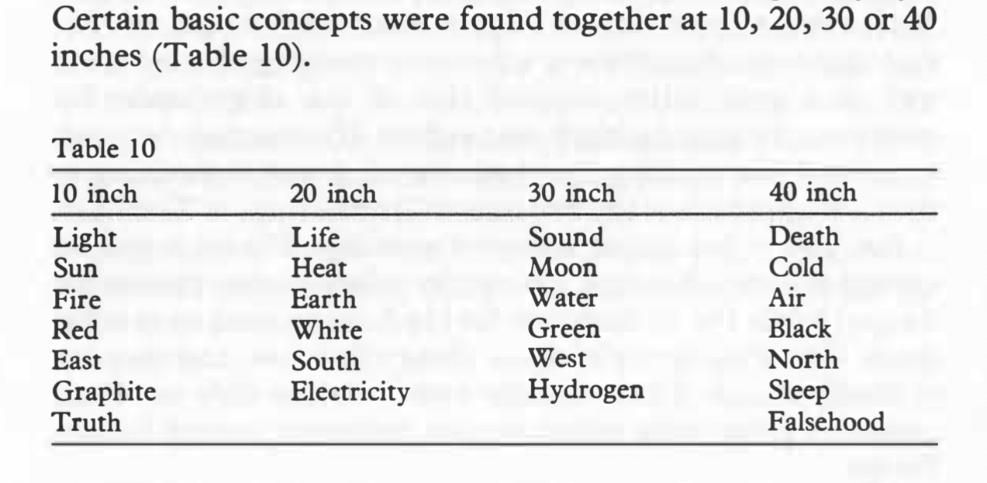
Dowsing and Metaphysics
Tom Lethbridge
The pendulum responds to the information encoded in an object; but also to ideas.
Rates are not randomly distributed, but (some at least) come in pairs of opposites.
Notes:
Essential p. 84: ‘Unless you can appreciate that there is part of your make-up which lasts indefinitely and knows much more than your brain, you are stuck in the world of materialism and atom bombs.’
Sling-shot at Wandlebury
Intelligent design
Immortality

Slide 14
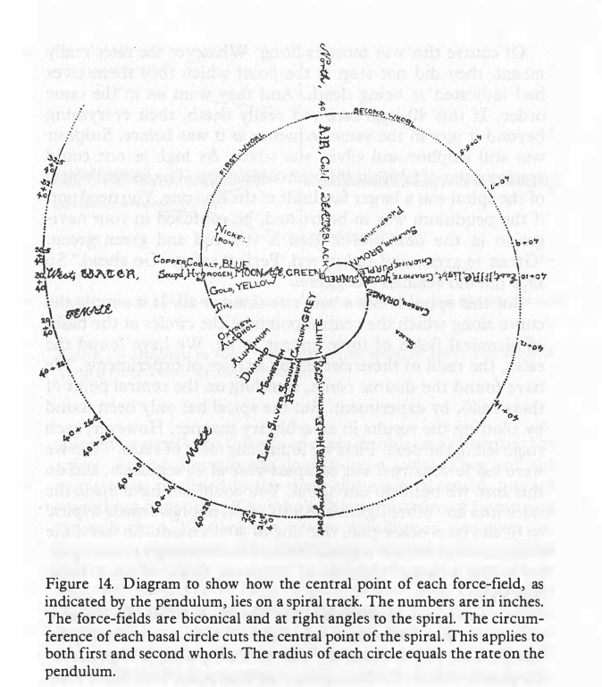
Dowsing and Metaphysics
Tom Lethbridge
An extraordinary demonstration of life after death (i.e. a rate of 40 inches), and further transcendent dimensions inherent in any object.
Notes:
Time is outside the 40 inch circle (at 60 inches) (Essential p. 100)
Materialism, as it is called, has forgotten one vital point. Brain and mind are not the same thing. Mind can work in many dimensions. Brain can only function in three. Since science by its terms of reference can only deal with these three dimen­sions, length, breadth and thickness, it is not the slightest guide to what happens when you have to deal with four or even more.
Essential p. 114

Slide 15
Conclusion
Both Underwood and Lethbridge are interested in what dowsing can tell us about the meaning of a phenomenon. Their dowsing is about understanding, not simply measuring and recording.
Both are on journeys, taking them ever further from a materialist-reductionist (natural scientific) view of the world, into a world in which humans engage profoundly and creatively with physical and transcendent realities.
Notes:
NB Lethbridge on time – Underwood cannot access history, Lethbridge has a complex account of overlapping and repeating time.

Slide 16
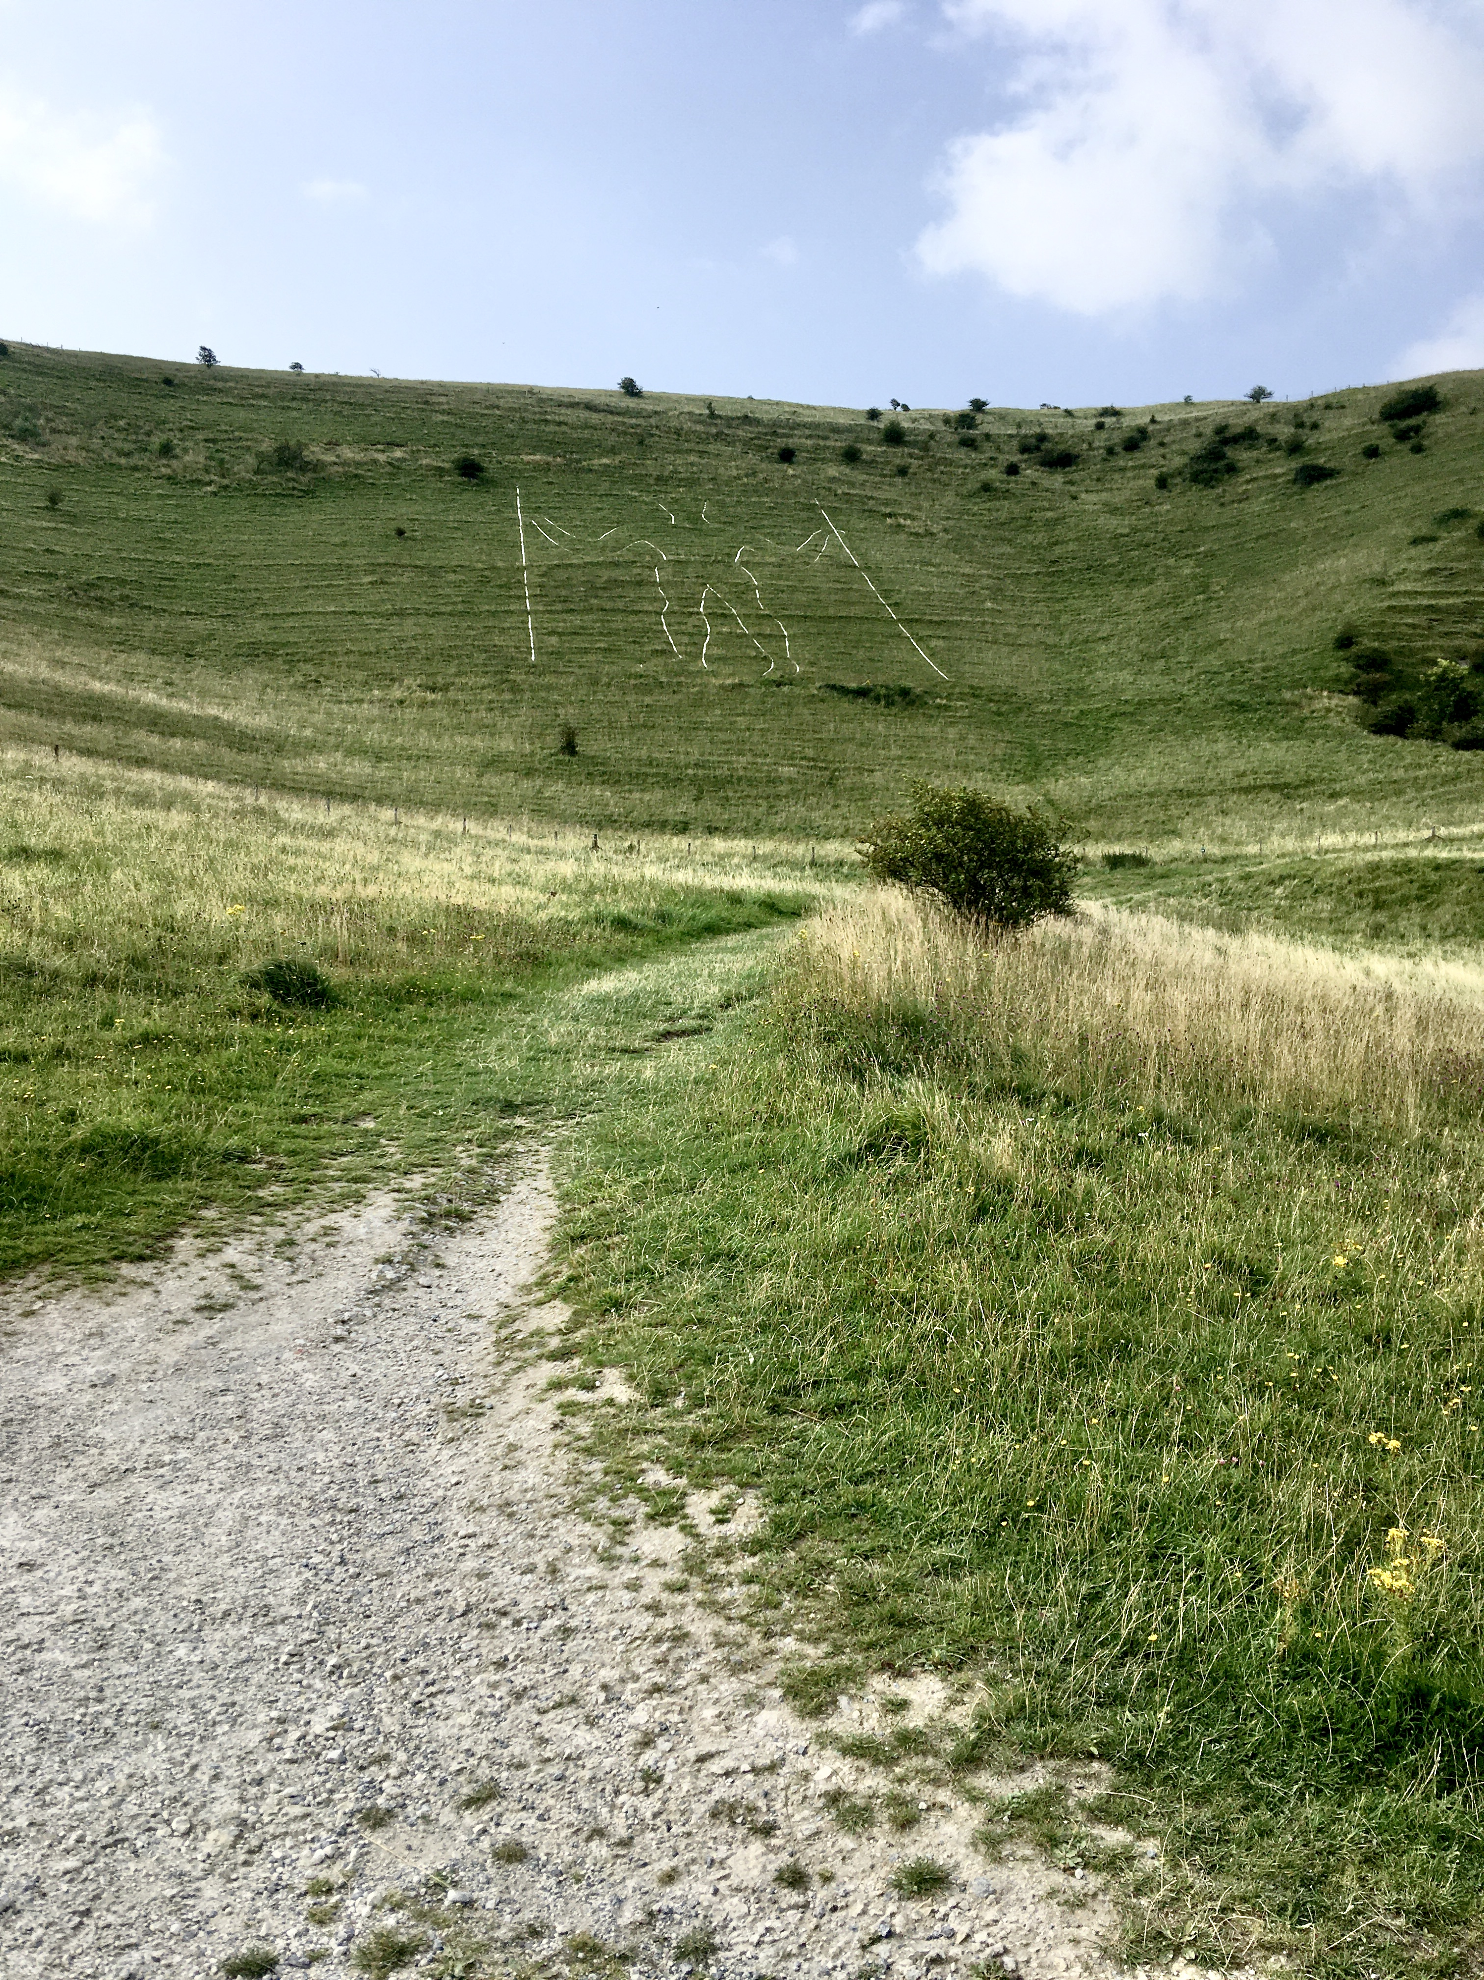
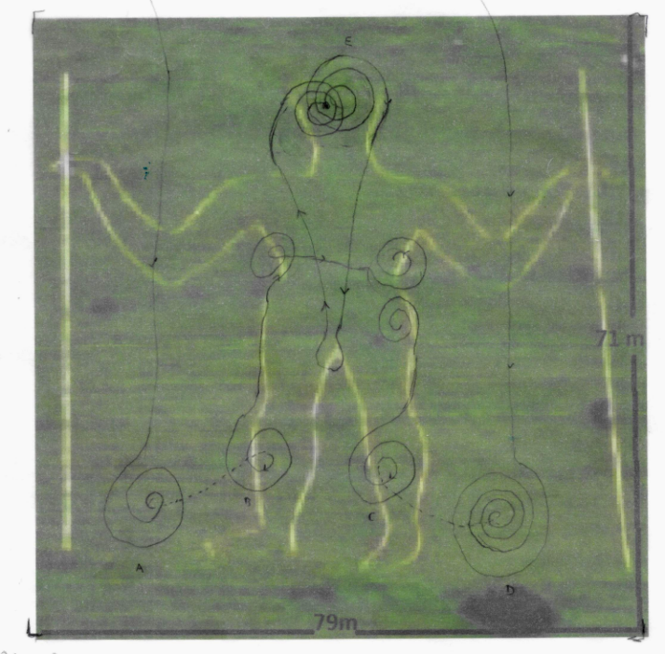
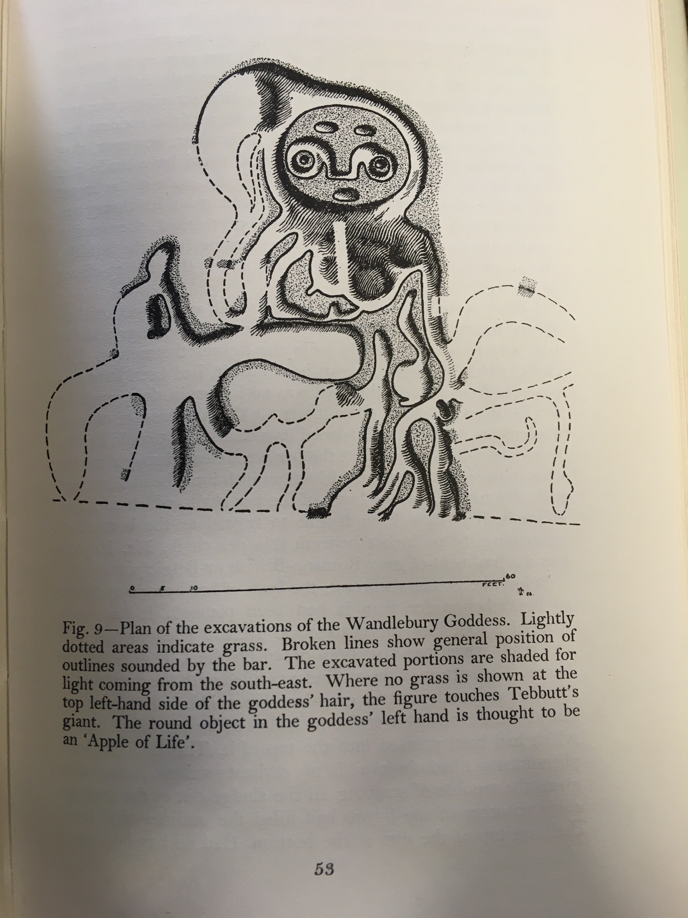
Conclusion
Underwood, Lethbridge and my own dowsing, at the Long Man of Wilmington (Waendelhelm)
Notes:
NB Lethbridge on time – Underwood cannot access history, Lethbridge has a complex account of overlapping and repeating time.

Slide 17
Reading
Guy Underwood
Tom Graves (ed.), Dowsing and Archaeology (1980)
The Pattern of the Past (1969)
Dennis and Maria Wheatley, Stonehenge (1995)
T. C. Lethbridge
Tom Graves and Janet Hoult (eds.), The Essential T. C. Lethbridge (1980)
William Sheppard (ed.), The World of T. C. Lethbridge (2009) [https://cesc.net/scholarweb/lethbridge/lethbridgeworld.pdf]
Notes:
NB Lethbridge on time – Underwood cannot access history, Lethbridge has a complex account of overlapping and repeating time.

Slide 18
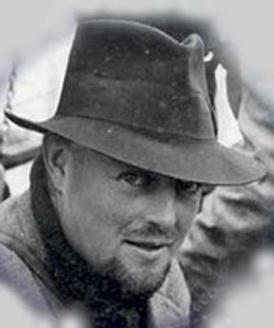
Reading
T. C. Lethbridge
1957 Gogmagog: The Buried Gods
1961 Ghost and Ghoul
1962 Witches: Investigating an Ancient Religion
1963 Ghost and Divining Rod
1965 ESP: Beyond Time and Distance
1967 A Step in the Dark
1969 The Monkey's Tail: A Study in Evolution and Parapsychology
1972 The Legend of the Sons of God: A Fantasy?
1976 The Power of the Pendulum
Notes:
NB Lethbridge on time – Underwood cannot access history, Lethbridge has a complex account of overlapping and repeating time.

